Slide 1
Blake Barker
Period 3

Slide 2
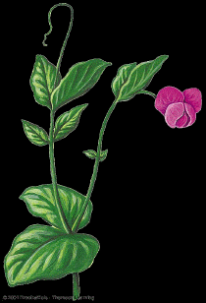
Just The Facts About Genetics
http://www.inlyschool.net/summer_reading/BookImages1-5/Bridging-Fluent/GregorMendel.jpg
http://trc.ucdavis.edu/biosci10v/bis10v/week4/pea.gif

Slide 3
Gregor Mendel
He was an monk who mostly did pastoral work at the St. Thomas Monastery of the Augustinian Order.
He did studies on the hereditary traits of pea plants. Mendel studied seven basic traits on about pea pods, and created the Laws of Heredity.
He lived from 1822- 1884, and did his heredity studies during the middle of his life.
He lived in Austria at his monastery.
He bred different types of pea plants together, and studied the traits of the parent plants and the daughter plants.

Slide 4
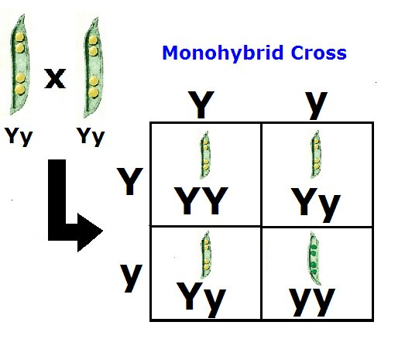
Monohybrid Crosses
Hybrid- the offspring produced by crossing two individuals of unlike genetic constitution; specifically, the offspring of two animals or plants of different races, varieties, species, etc.
P₁ - The parent generation of plants
F₁ - The first generation of daughter plants.
F₂ – The second generation of daughter plants.
The phenotype ratio of the F₂ generation is 3:1.
http://lh6.ggpht.com/_e7iFuv4nxlY/RvmYLP4wm3I/AAAAAAAAADw/MktdHz8cABQ/Monohybrid+3+1.bmp

Slide 5
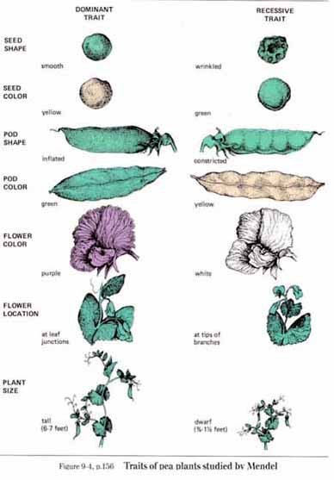
Seven Traits Of Peas
Seed shape: The peas are either smooth or wrinkled
Seed color: yellow or green
Pod Shape: Inflated or Constricted
Pod Color: Green Or Yellow
Flower Color: purple or white.
Flower Location: Leaf Conjunctions- At tips of branches
Plant size: Tall or Dwarf
http://carolguze.com/images/Gen_Genetics/seven_pea_traits.jpg

Slide 6
The Rule Of Unit Factors
There are two factors in an organism that affect each of it’s traits; genes that exist in alternate forms, called alleles.

Slide 7
The Rule of Dominance
Dominant Traits- traits that only need one allele to become active; represented by capital letter.
Recessive Traits- traits that require both alleles to be active; represented by lowercase letter.
Dominant Allele
Tt
Recessive Allele

Slide 8
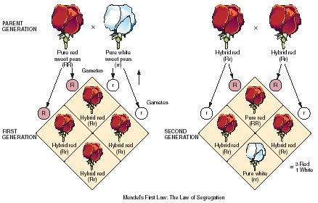
The Law Of Segregation
The P₁ generation pea plants with “TT” and “tt” traits give a dominant and a recessive allele to every one of their offspring.
Because each F₁ generation pea plant contains both dominant and recessive alleles, it can produce two types of gametes: a tall one and a short one.
During fertilization, these gametes randomly pair to produce four combinations of alleles.
http://www.scienceclarified.com/images/uesc_07_img0360.jpg

Slide 9
Phenotypes And Genotypes
Phenotype- the way on organism looks and behaves according to it’s traits.
Genotype- the allele combination an organism contains.
Homozygous- Containing a trait with two matching alleles (i.e. “TT” or “tt”).
Heterozygous- Containing a trait with alleles that do not match (i.e. “Tt”).

Slide 10
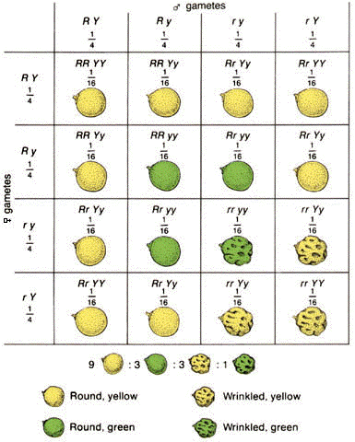
Dihybrid Crosses
Dihybrid- involving the cross of two different traits
Phenotype Ratio: 9:3:3:1
URL: http://www.biologycorner.com/resources/dihybrid_cross.gif

Slide 11
The Law Of Independent Assortment
A RrYy parent plant can form 4 differing gametes with equal frequency; they are as follows: Round Yellow, Round Green, Wrinkled Yellow , and Wrinkled Green. In terms of alleles, there are a total of 9 possible combinations: RRYY, RrYY, RrYy, rrYy, rryy, Rryy, rrYY, RRyy, and RRYy.

